Slide 1
CSE 305 Computer Architecture Instructions
Saem Hasan
Lecturer, CSE, BUET
Prepared by
Madhusudan Basak
Assistant Professor, CSE, BUET
*Some modifications done by Saem Hasan

Slide 2
Instructions
A computer is run by instructions
Instruction Set
All possible instructions for a CPU

Slide 3
Instruction Set Architecture
Instruction set architecture is the attributes of a computing system as seen by the assembly language programmer or compiler.
Instruction Set (what operations can be performed?)
Instruction Format (how are instructions specified?)
Data storage (where is data located?)
Addressing Modes (how is data accessed?)
Exceptional Conditions (what happens if something goes wrong?)

Slide 4
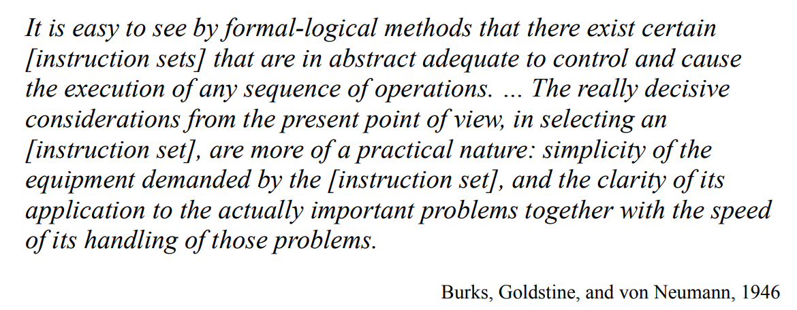
Design Philosophy

Slide 5
MIPS Architecture
Acronym of “Microprocessor without Interlocked Pipelined Stages”
Is a RISC (Reduced Instruction Set Computer) ISA (Instruction Set Architecture)
Developed by MIPS Technologies (then MIPS Computer Systems) in 1985

Slide 6
Design Principles
Design Principle 1: Simplicity favors regularity.
Design Principle 2: Smaller is faster.
Design Principle 3: Good design demands good compromises.

Slide 7
Simplicity favors regularity
The instructions of MIPS are fixed and rigid
Rigidity ensures Regularity
Simplicity favors regularity

Slide 8



Example Instruction
$Add$ and $subtract$ instructions always follow the following fixed format
$$a=b+c+d+e$$

Slide 9



Example Instruction
$Add$ and $subtract$ instructions always follow the following fixed format

Slide 10
MIPS Instruction Properties
Arithmetic operations only takes register values as operands
Size of a register : 32 bit
Number of registers: 32
Satisfies Design Principle 2: Smaller is faster.
Large number of registers -> longer time for electronic signal to travel -> Increased clock cycle
Large number of registers -> Increased number of control bits
A number is dedicated to a particular register.
5 bit are reserved to indicate each register when the count is 32
Compiler maps a program variable to a register
There is a number assigned against each register

Slide 11

MIPS Instruction Properties
Example

Slide 12
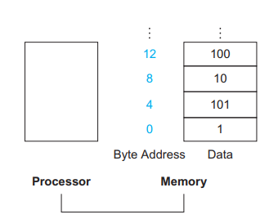
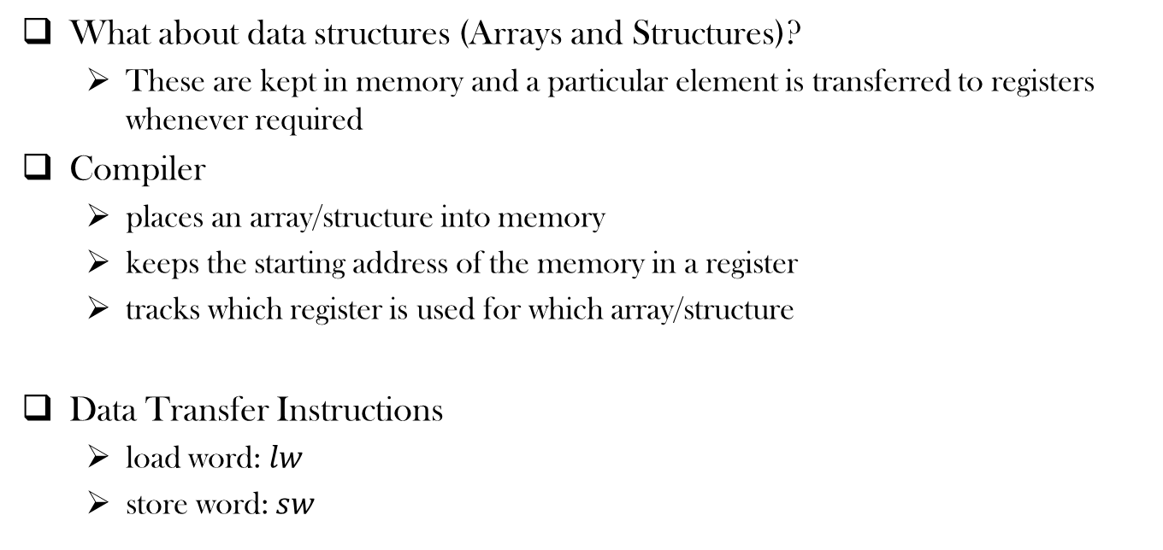
MIPS Instruction Properties
What about data structures (Arrays and Structures)?
These are kept in memory and a particular element is transferred to registers whenever required
Compiler
places an array/structure into memory
keeps the starting address of the memory in a register
tracks which register is used for which array/structure
Data Transfer Instructions
load word: $lw$
store word: $sw$

Slide 13


Data Transfer Instructions
Example
$A\left[12\right]=h+A[8]$

Slide 14
Spilling Registers
What if the number of variables and data structures is more than 32?
﻿The process of putting less commonly used variables into memory is called Spilling Registers.
Keeps the most frequently used variables in registers and less frequents one in memory
Moves variables around registers and memory

Slide 15
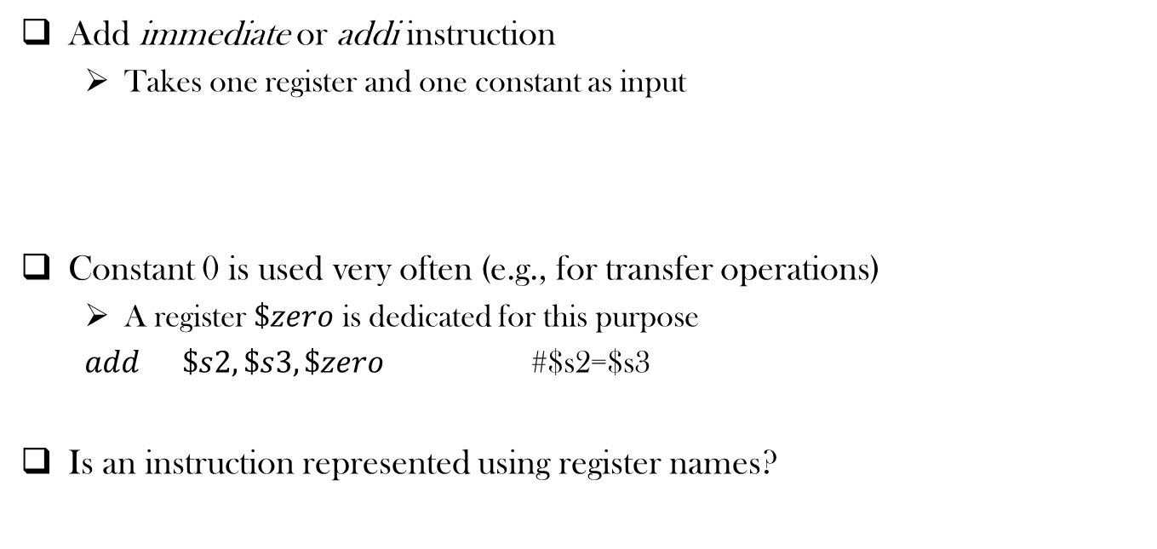
Operation with Constants
Add immediate or addi instruction
Takes one register and one constant as input
Constant 0 is used very often (e.g., for transfer operations)
A register $\$zero$ is dedicated for this purpose
$add \$s2, \$s3,\$zero$ #$s2=$s3
Is an instruction represented using register names?

Slide 16
Representing Instructions in the Computer
Key principles of Today’s computer instructions
Instructions are represented as numbers
Program are stored in memory to be read or written, just like data

Slide 17
Representing Instructions in the Computer
An instruction is a sequence of bits
Each register is mapped to a number
There is a convention to map register names into numbers (e.g., registers $s0 to $s7 map onto registers 16 to 23)
Each instruction is 32 bit long (size of a word)
Satisfies Design Principle 1: Simplicity favors regularity.
Instruction Format: format used by an instruction

Slide 18
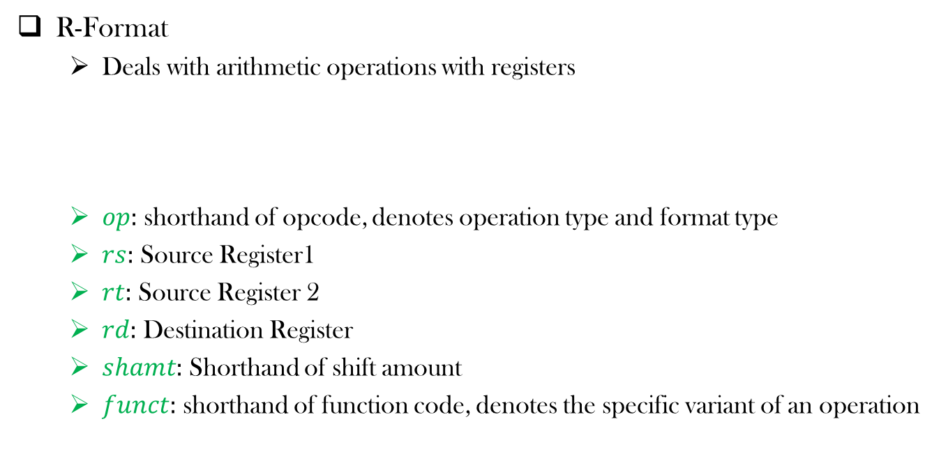
An MIPS Instruction Format
R-Format
Deals with arithmetic operations with registers
$op:$ shorthand of opcode, denotes operation type and format type
$rs:$ Source Register1
$rt:$ Source Register 2
$rd:$ Destination Register
$shamt:$ Shorthand of shift amount
$funct:$ shorthand of function code, denotes the specific variant of an operation

Slide 19
An MIPS Instruction Format
Would it be good to use just one format for all kind of operations?
No!
Design Principle 3: Good design demands good compromises.

Slide 20

Another MIPS Instruction Format
I-Format
Deals with immediate and data transfer operations
$rt:$ Here $rt$ represents the destination register

Slide 21
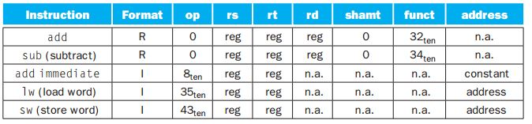

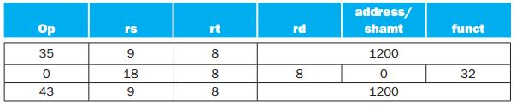

MIPS Instruction Encoding (Simplified)

Slide 22
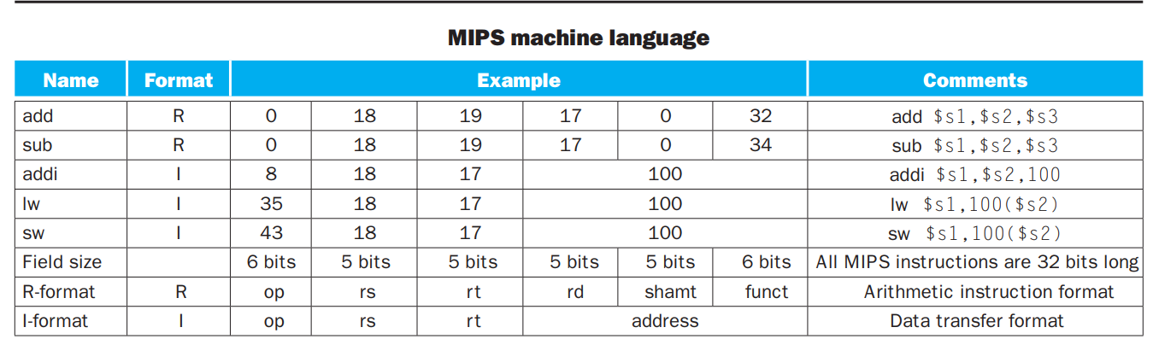
Summary

Slide 23
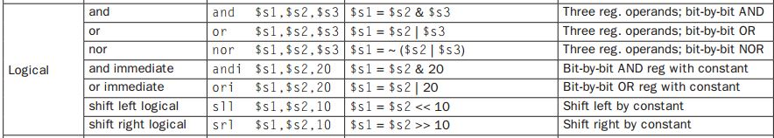
Logical Operations
No NOT Operation?

Slide 24
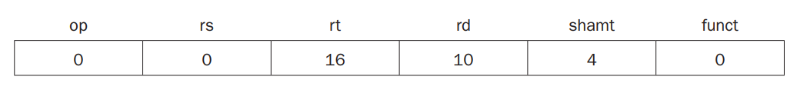
Shift Left
sll $t2,$s0,4 # reg $t2 = reg $s0 << 4 bits

Slide 25
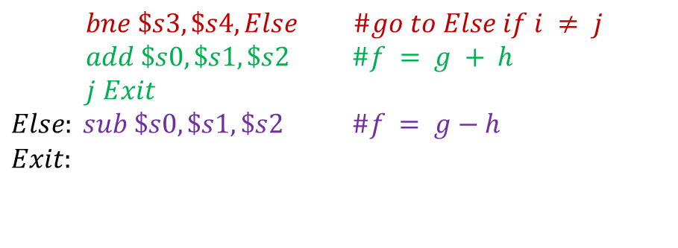
Branching Operations
if (i==j)
f = g + h;
else
f = g – h;
$$bne \$s3, \$s4, Else \#go to Else if i ≠ j$$
$$add \$s0, \$s1, \$s2 \#f = g + h$$
$$j Exit$$
$$Else: sub \$s0, \$s1, \$s2 \#f = g−h$$
$$\begin{aligned}Exit:\end{aligned}$$
Why not blt?

Slide 26
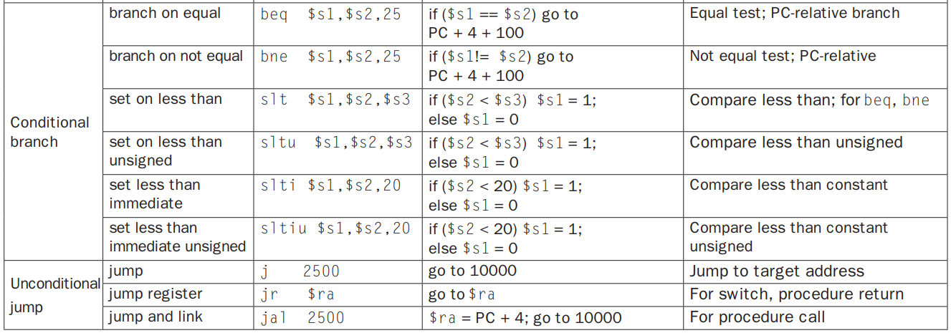
Branching Operations

Slide 27
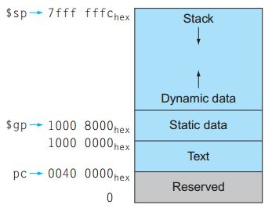
Memory Allocation for Program and Data
Reserved Memory
Text Segment: Program Code
Static Data Segment:
Contains static variables, constants, arrays
Dynamic Data Segment (Heap):
Contains linked lists, variable length data
Stack
Contains function local variables, parameters etc.

Slide 28
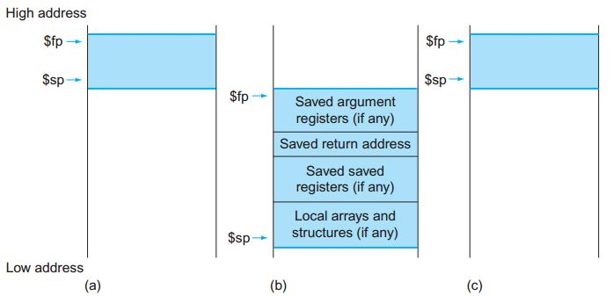
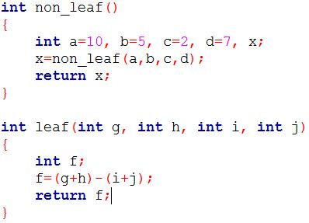
Stack During Procedure Call
Stores/saves the values of registers and Restores those later
Either $sp and $fp combination, or only $sp is used
The allocated stack area by a procedure is known as activation record or procedure frame

Slide 29
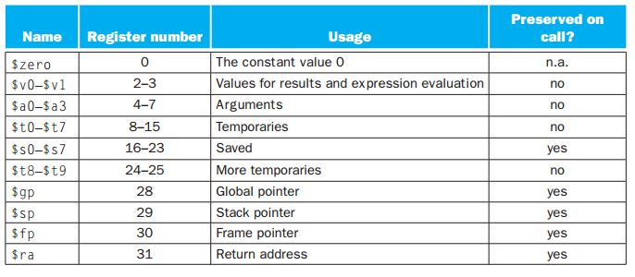
Stack During Procedure Call
Stores the values of registers

Slide 30
Procedures in MIPS
Six steps during a procedure call
Put parameters in a place where the procedure can access them.
Transfer control to the procedure.
Acquire the storage resources needed for the procedure.
Perform the desired task.
Put the result value in a place where the calling program can access it.
Return control to the point of origin, since a procedure can be called from several points in a program.

Slide 31
Procedures in MIPS
Six steps during a procedure call
Put parameters in a place where the procedure can access them.
Transfer control to the procedure.
Acquire the storage resources needed for the procedure.
Perform the desired task.
Put the result value in a place where the calling program can access it.
Return control to the point of origin, since a procedure can be called from several points in a program.
Place for parameters:
$a0–$a3: four argument registers in which to pass parameters
Memory (e.g., stack) can be used if more values to be passed

Slide 32
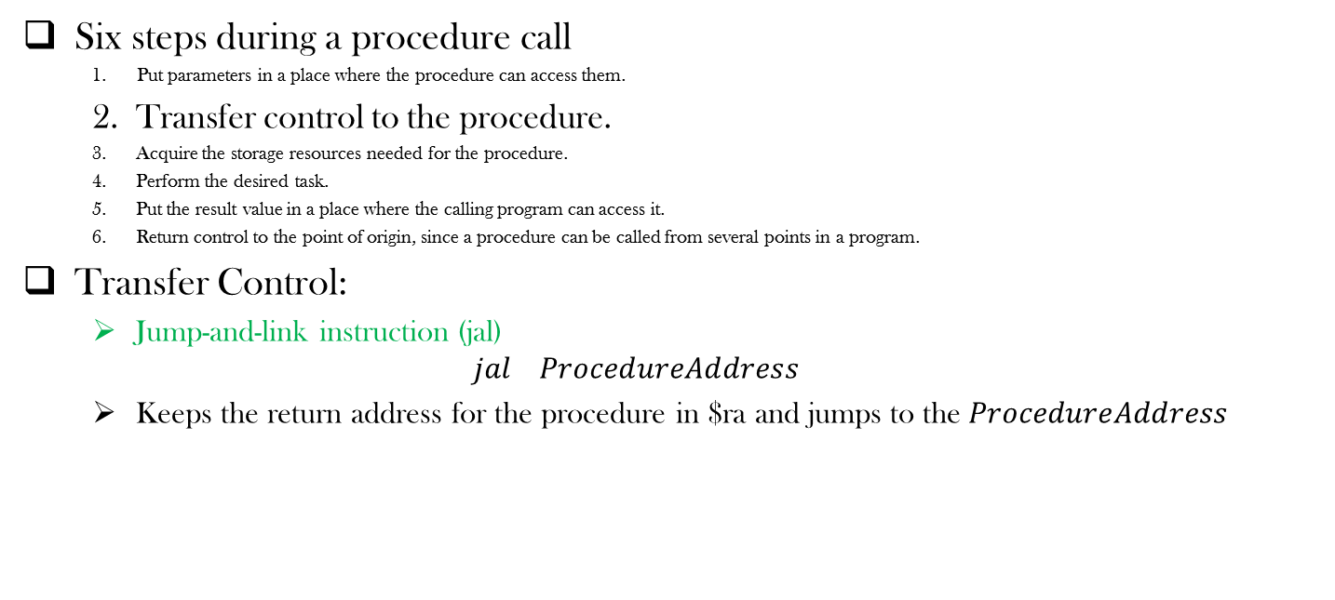
Procedures in MIPS
Six steps during a procedure call
Put parameters in a place where the procedure can access them.
Transfer control to the procedure.
Acquire the storage resources needed for the procedure.
Perform the desired task.
Put the result value in a place where the calling program can access it.
Return control to the point of origin, since a procedure can be called from several points in a program.
Transfer Control:
Jump-and-link instruction (jal)
$$jal ProcedureAddress$$
Keeps the return address for the procedure in $ra and jumps to the $ProcedureAddress$

Slide 33
Procedures in MIPS
Six steps during a procedure call
Put parameters in a place where the procedure can access them.
Transfer control to the procedure.
Acquire the storage resources needed for the procedure.
Perform the desired task.
Put the result value in a place where the calling program can access it.
Return control to the point of origin, since a procedure can be called from several points in a program.
Acquiring the storage resources
Different register values (manipulated by caller) are stored in the stack
Prepares the registers for operations
Can use the memory for data storage

Slide 34
Procedures in MIPS
Six steps during a procedure call
Put parameters in a place where the procedure can access them.
Transfer control to the procedure.
Acquire the storage resources needed for the procedure.
Perform the desired task.
Put the result value in a place where the calling program can access it.
Return control to the point of origin, since a procedure can be called from several points in a program.

Slide 35
Procedures in MIPS
Six steps during a procedure call
Put parameters in a place where the procedure can access them.
Transfer control to the procedure.
Acquire the storage resources needed for the procedure.
Perform the desired task.
Put the result value in a place where the calling program can access it.
Return control to the point of origin, since a procedure can be called from several points in a program.
Performing Tasks
Can perform all the operations allowed by the MIPS instruction set

Slide 36
Procedures in MIPS
Six steps during a procedure call
Put parameters in a place where the procedure can access them.
Transfer control to the procedure.
Acquire the storage resources needed for the procedure.
Perform the desired task.
Put the result value in a place where the calling program can access it.
Return control to the point of origin, since a procedure can be called from several points in a program.
Result storing by the callee
$v0–$v1: two value registers in which to return values
Memory (e.g., stack) can be used if more values to be returned

Slide 37
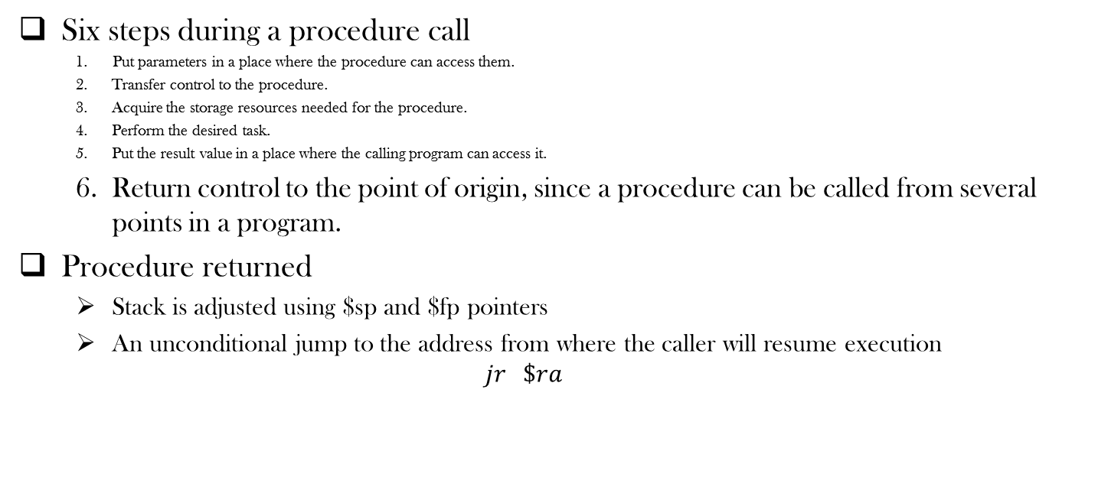
Procedures in MIPS
Six steps during a procedure call
Put parameters in a place where the procedure can access them.
Transfer control to the procedure.
Acquire the storage resources needed for the procedure.
Perform the desired task.
Put the result value in a place where the calling program can access it.
Return control to the point of origin, since a procedure can be called from several points in a program.
Procedure returned
Stack is adjusted using $sp and $fp pointers
An unconditional jump to the address from where the caller will resume execution
$$jr \$ra$$

Slide 38
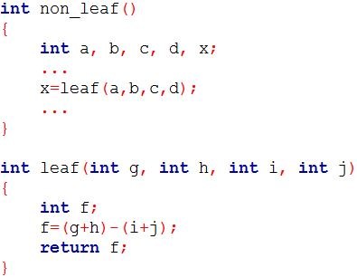
An Example
non_leaf:
...
add $a0, $s1, $zero
add $a1, $s2, $zero
add $a2, $s3, $zero
add $a3, $s4, $zero
jal leaf
add $s1, $zero, $v0
...
leaf: addi $sp, $sp, –12 # adjust stack to make room for 3 items
sw $t1, 8($sp) # save register $t1 for use afterwards
sw $t0, 4($sp) # save register $t0 for use afterwards
sw $s0, 0($sp) # save register $s0 for use afterwards
add $t0,$a0,$a1 # register $t0 contains g + h
add $t1,$a2,$a3 # register $t1 contains i + j
sub $s0,$t0,$t1 # f = $t0 – $t1, which is (g + h)–(i + j)
add $v0,$s0,$zero # Set return Value
lw $s0, 0($sp) # restore register $s0 for caller
lw $t0, 4($sp) # restore register $t0 for caller
lw $t1, 8($sp) # restore register $t1 for caller
addi $sp,$sp,12 # adjust stack to delete 3 items
jr $ra # jump back to calling routine
Put parameters in a place where the procedure can access them.
Transfer control to the procedure.
Acquire the storage resources needed for the procedure
Perform the desired task.
Put the result value in a place where the calling program can access it.
Return control to the point of origin, since a procedure can be called from several points in a program.

Slide 39
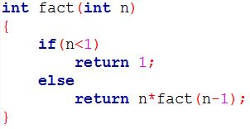
Nested Call
fact: addi $sp, $sp, –8 # adjust stack for 2 items
sw $ra, 4($sp) # save the return address
sw $a0, 0($sp) # save the argument n
slti $t0,$a0,1 # test for n < 1
beq $t0,$zero,L1 # if n >= 1, go to L1
addi $v0,$zero,1 # Set the return value
addi $sp,$sp,8 # pop 2 items off stack
jr $ra # return to caller
L1: addi $a0,$a0,–1 # n >= 1: argument gets (n – 1)
jal fact # call fact with (n –1)
lw $a0, 0($sp) # return from jal: restore argument n
lw $ra, 4($sp) # restore the return address
addi $sp, $sp, 8 # adjust stack pointer to pop 2 items
mul $v0,$a0,$v0 # return n * fact (n – 1)
jr $ra # return to the caller

Slide 40
J-Format
To support long jump to a remote procedure address
opcode
Jumping Address

Slide 41
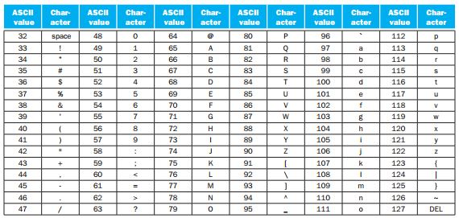
ASCII representation of characters
ASCII stands for American Standard Code for Information Interchange
Uses 1 byte to represent a character

Slide 42
1 Byte Memory Operation
ASCII demands 1-byte memory operation
MIPS supports
lb $t0,0($sp) #Reads 1 byte from memory and stores in the lowest (rightmost) byte of $t0
sb $t0,0($gp) #Reads 1 byte from the lowest (rightmost) byte of $t0 and stores in the memory
Unsigned Version:
Load Byte: lbu
Store Byte: Not available in MIPS

Slide 43
Dealing with Strings
Three commonly available strategies
the first position of the string is reserved to give the length of a string
an accompanying variable has the length of the string
the last position of a string is indicated by a character used to mark the end of a string

Slide 44
Dealing with String: Example
ASCII demands 1-byte memory operation
MIPS supports
lb $t0,0($sp) #Reads 1 byte from memory and stores in the lowest (rightmost) byte of $t0
sb $t0,0($gp) #Reads 1 byte from the lowest (rightmost) byte of $t0 and stores in the memory
Unsigned Version:
Load Byte: lbu
Store Byte: Not available in MIPS

Slide 45
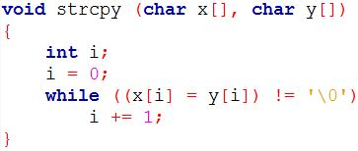
Dealing with String: An Example
strcpy: addi $sp,$sp,–4 # adjust stack for 1 more item
sw $s0, 0($sp) # save $s0
add $s0,$zero,$zero # i = 0 + 0
L1: add $t1,$s0,$a1 # address of y[i] in $t1
lbu $t2, 0($t1) # $t2 = y[i]
add $t3,$s0,$a0 # address of x[i] in $t3
sb $t2, 0($t3) # x[i] = y[i]
beq $t2,$zero,L2 # if y[i] == 0, go to L2
addi $s0, $s0,1 # i = i + 1
j L1 # go to L1. While loop continues
L2: lw $s0, 0($sp) # End of string. Restore old $s0
addi $sp,$sp,4 # pop 1 word off stack
jr $ra # return

Slide 46
String Copy Example
MIPS code:
strcpy: addi $sp, $sp, -4 # adjust stack for 1 item sw $s0, 0($sp) # save $s0 add $s0, $zero, $zero # i = 0 L1: add $t1, $s0, $a1 # addr of y[i] in $t1 lbu $t2, 0($t1) # $t2 = y[i] add $t3, $s0, $a0 # addr of x[i] in $t3 sb $t2, 0($t3) # x[i] = y[i] beq $t2, $zero, L2 # exit loop if y[i] == 0 addi $s0, $s0, 1 # i = i + 1 j L1 # next iteration of loop L2: lw $s0, 0($sp) # restore saved $s0 addi $sp, $sp, 4 # pop 1 item from stack jr $ra # and return

Slide 47
Dealing with Multiple Languages
Unicode, a universal encoding, supports alphabets of most human languages
Java uses Unicode
Requires 16 bits to represent a character
Operations required to load and store 16bits (halfwords)
Load halfword: lh
Load halfword unsigned: lhu
Store halfword: sh

Slide 48
Constant Size: Is larger feasible?
The I-format is used by both immediate and memory data transfer operations
More than 16 bit long constant?
We have two options in hand
Supporting short constant in 1 instruction and deal long constant with additional instructions
Supporting long constant in 2 instructions
We opted for the first option (to exploit the benefit of common case fast)
Are we limited to use 16 bit constants (-32,768 to 32,767)?
No ☺ Use two instructions to populate a register with 32 bit constant

Slide 49
Manipulating Larger Constant
Populating a register with 32 bit constant
Load Upper Immediate (lui) : Loads upper 16 bits
Or Immediate (ori): : Loads lower 16 bits
Example: x=y+4000000
4000000 = 0000 0000 0011 1101 0000 1001 0000 0000
lui $s0, 61 // 61 = 0000 0000 0011 1101
ori $s0, 2304 // 2304= 0000 1001 0000 0000
add $s1, $t0, $s0
Think how to use 32 bit address to access data from memory
No sign extension for logical operations but it happens for arithmetic operations
$s0
0000 0000 0011 1101
0000 0000 0000 0000
0000 1001 0000 0000
0000 0000 0000 0000
0000 1001 0000 0000

Slide 50
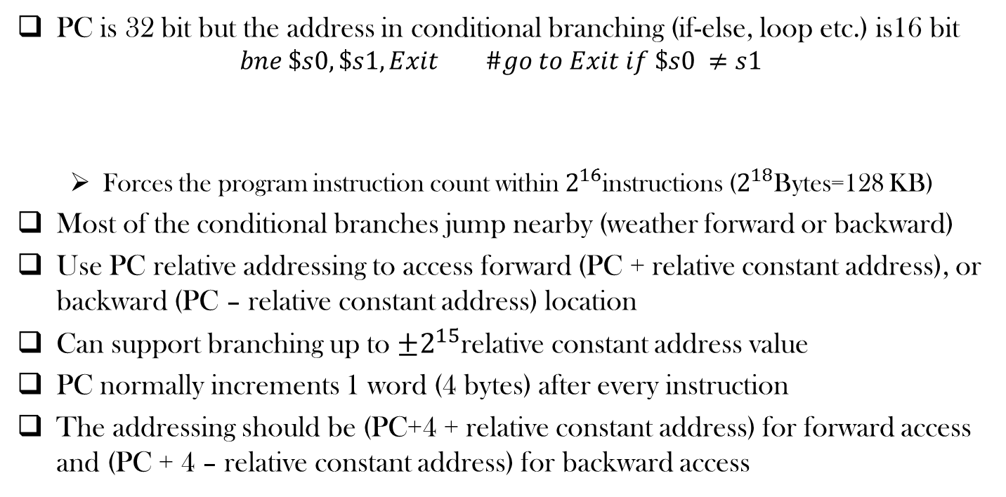
Addressing in Branches
PC is 32 bit but the address in conditional branching (if-else, loop etc.) is16 bit
$$bne \$s0, \$s1, Exit \#go to Exit if \$s0 ≠s1$$
Forces the program instruction count within $2^{16}$instructions ($2^{18}$Bytes=128 KB)
Most of the conditional branches jump nearby (weather forward or backward)
Use PC relative addressing to access forward (PC + relative constant address), or backward (PC – relative constant address) location
Can support branching up to $±2^{15}$relative constant address value
PC normally increments 1 word (4 bytes) after every instruction
The addressing should be (PC+4 + relative constant address) for forward access and (PC + 4 – relative constant address) for backward access

Slide 51
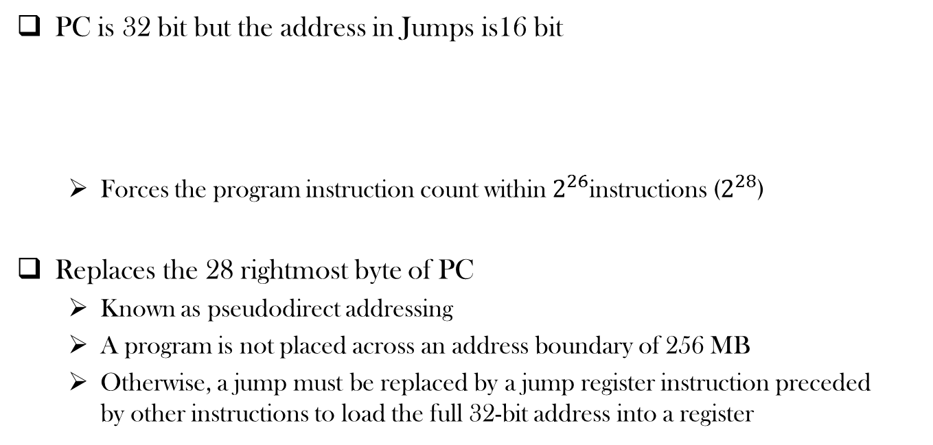

Addressing in Jumps
PC is 32 bit but the address in Jumps is16 bit
Forces the program instruction count within $2^{26}$instructions ($2^{28}$)
opcode
Jumping Address

Slide 52
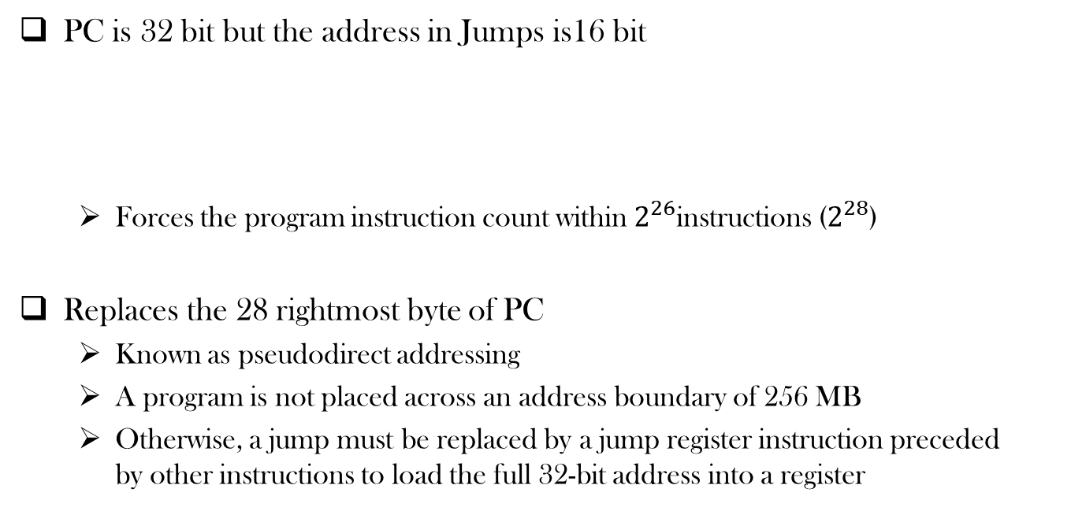
Addressing in Jumps
PC is 32 bit but the address in Jumps is16 bit
Forces the program instruction count within $2^{26}$instructions ($2^{28}$)
Replaces the 28 rightmost byte of PC
Known as pseudodirect addressing
A program is not placed across an address boundary of 256 MB
Otherwise, a jump must be replaced by a jump register instruction preceded by other instructions to load the full 32-bit address into a register
opcode
Jumping Address

Slide 53
Food for Thought
Can you reverse engineer a binary?
Is your IP secured?

Slide 54
Jump Addressing
Jump (j and jal) targets could be anywhere in text segment
Encode full address in instruction
op
address
6 bits
26 bits
(Pseudo)Direct jump addressing
Target address = PC_{31…28} : (address × 4)

Slide 55
Target Addressing Example
Loop code from earlier example
Assume Loop at location 80000
Loop: sll $t1, $s3, 2 | 80000 | 0 | 0 | 19 | 9 | 4 | 0
add $t1, $t1, $s6 | 80004 | 0 | 9 | 22 | 9 | 0 | 32
lw $t0, 0($t1) | 80008 | 35 | 9 | 8 | 0
bne $t0, $s5,Exit | 80012 | 5 | 8 | 21 | 2
addi $s3, $s3, 1 | 80016 | 8 | 19 | 19 | 1
j Loop | 80020 | 2 | 20000
Exit: … | 80024

Slide 56
Branching Far Away
If branch target is too far to encode with 16-bit offset, assembler rewrites the code
Example
beq $s0,$s1, L1
↓
bne $s0,$s1, L2 j L1 L2: …

Slide 57
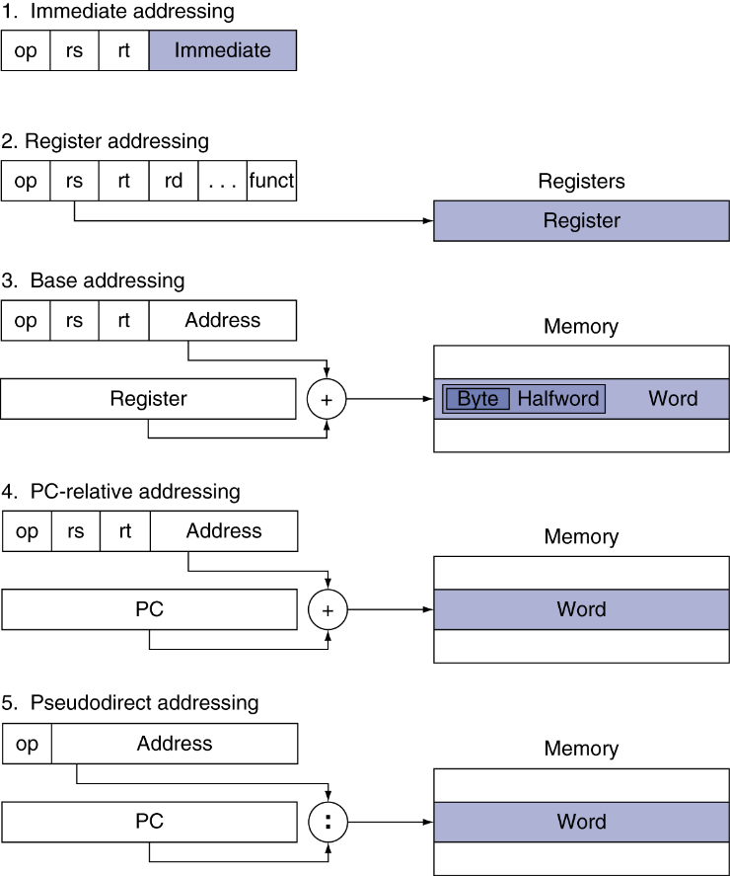
Addressing Mode Summary

Slide 58
Synchronization
Two processors sharing an area of memory
P1 writes, then P2 reads
Data race if P1 and P2 don’t synchronize
Result depends of order of accesses
Hardware support required
Atomic read/write memory operation
No other access to the location allowed between the read and write
Could be a single instruction
E.g., atomic swap of register ↔ memory
Or an atomic pair of instructions
§2.11 Parallelism and Instructions: Synchronization

Slide 59
Synchronization in MIPS
Load linked: ll rt, offset(rs)
Store conditional: sc rt, offset(rs)
Succeeds if location not changed since the ll
Returns 1 in rt
Fails if location is changed
Returns 0 in rt
Example: atomic swap (to test/set lock variable)
try: add $t0,$zero,$s4 ;copy exchange value
ll $t1,0($s1) ;load linked
sc $t0,0($s1) ;store conditional
beq $t0,$zero,try ;branch store fails
add $s4,$zero,$t1 ;put load value in $s4
Notes:
The idea is that you use LL to load the value stored at a memory location into a register, modify it however you like there, and subsequently write it back to the same place using SC. SC will only overwrite the value in memory with your modified one if no other processor has altered it while you were working on the copy in the register. It has the side-effect of setting a status flag to indicate whether or not it was successful.

Slide 60
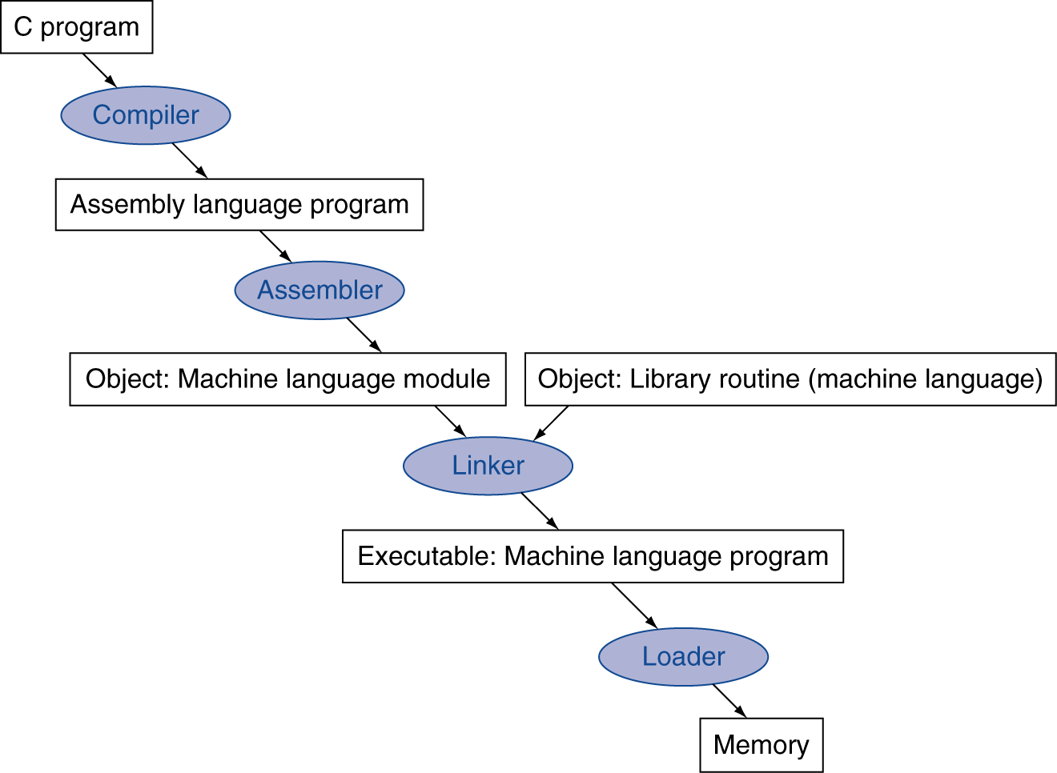
Translation and Startup
Many compilers produce object modules directly
§2.12 Translating and Starting a Program
Static linking

Slide 61
Assembler Pseudoinstructions
Most assembler instructions represent machine instructions one-to-one
Pseudoinstructions: figments of the assembler’s imagination
move $t0, $t1 → add $t0, $zero, $t1
blt $t0, $t1, L → slt $at, $t0, $t1 bne $at, $zero, L
$at (register 1): assembler temporary

Slide 62
Producing an Object Module
Assembler (or compiler) translates program into machine instructions
Provides information for building a complete program from the pieces
Header: described contents of object module
Text segment: translated instructions
Static data segment: data allocated for the life of the program
Relocation info: for contents that depend on absolute location of loaded program
Symbol table: global definitions and external refs
Debug info: for associating with source code

Slide 63
Linking Object Modules
Produces an executable image
1. Merges segments
2. Resolve labels (determine their addresses)
3. Patch location-dependent and external refs
Could leave location dependencies for fixing by a relocating loader
But with virtual memory, no need to do this
Program can be loaded into absolute location in virtual memory space

Slide 64
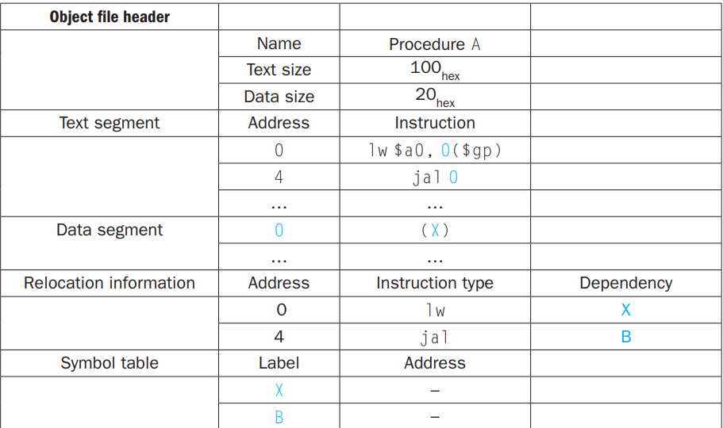
Object 1

Slide 65
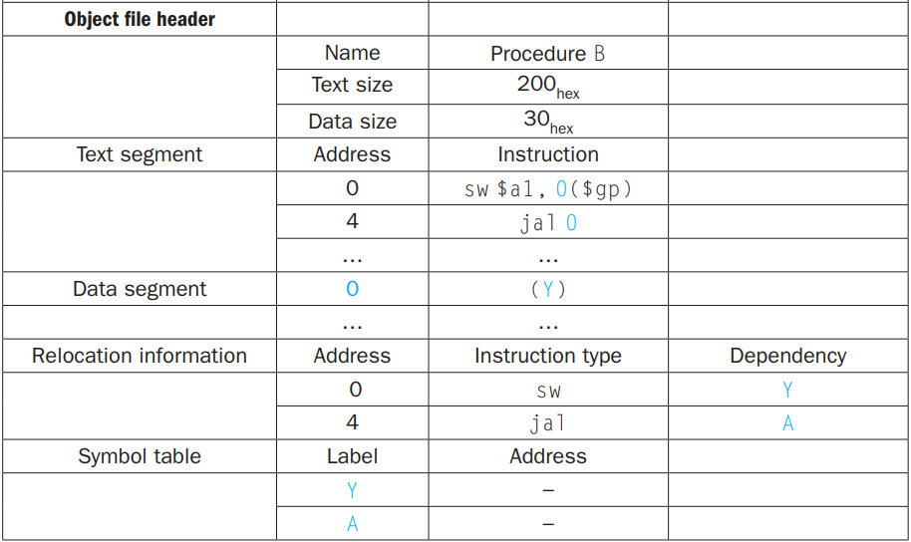
Object 2

Slide 66
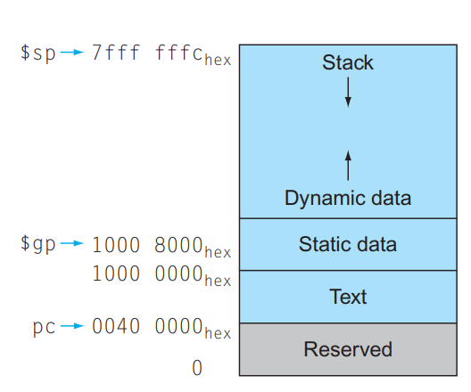

Slide 67
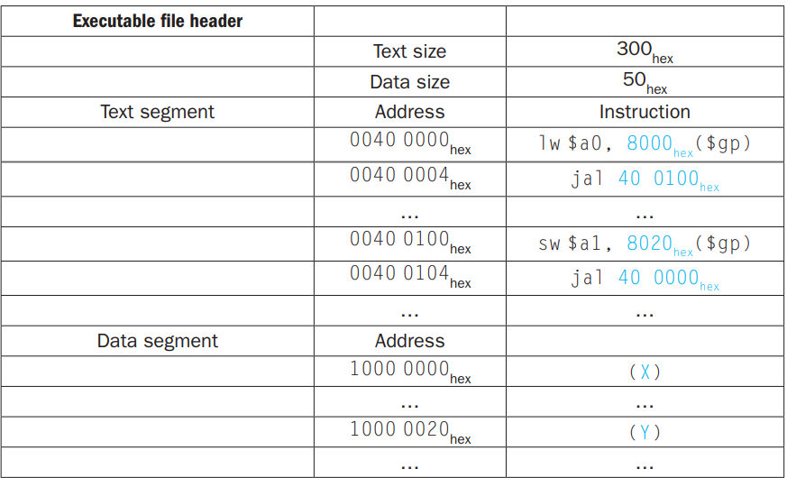
Merged Object

Slide 68
Loading a Program
Load from image file on disk into memory
1. Read header to determine segment sizes
2. Create virtual address space
3. Copy text and initialized data into memory
Or set page table entries so they can be faulted in
4. Set up arguments on stack
5. Initialize registers (including $sp, $fp, $gp)
6. Jump to startup routine
Copies arguments to $a0, … and calls main
When main returns, do exit syscall

Slide 69
Dynamic Linking
Only link/load library procedure when it is called
Requires procedure code to be relocatable
Avoids image bloat caused by static linking of all (transitively) referenced libraries
Automatically picks up new library versions

Slide 70
Dynamically Linked Libraries (DLL)
Library routines that are linked to a program during execution
To incorporate the updated version of library routines
In lazy procedure linkage, each routine is linked only when it is called
Provides a level of indirection
Nonlocal routine calls a set of dummy entries at the end of the program, with one entry per nonlocal routine. These dummy entries each contain an indirect jump
The Dynamic Linker/Loader finds the desired routine, remaps it, and changes the address in the indirect jump location to point to that routine
From then, the call to the library routine jump indirectly to routine without the extra hops

Slide 71
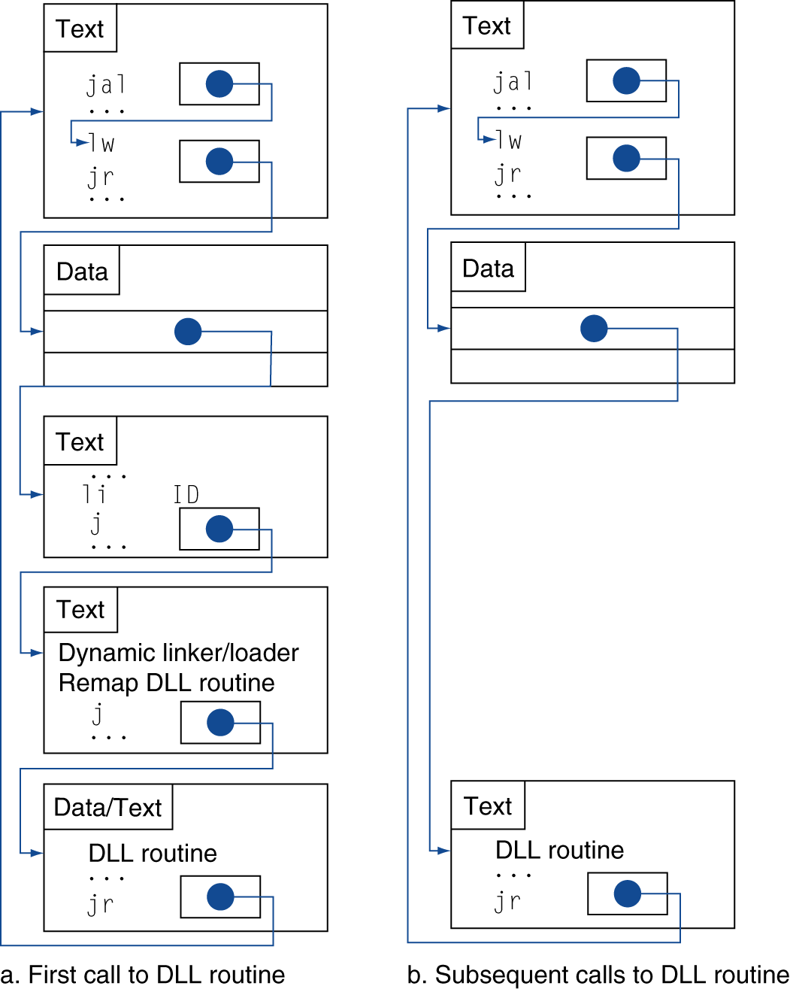
Lazy Linkage
Indirection table
Stub: Loads routine ID, Jump to linker/loader
Linker/loader code
Dynamically mapped code

Slide 72
Starting a Java Program
Java programs ensure portability sacrificing some performance
Compiled first in to an easy-to-interpret instruction set: Java bytecode
A software interpreter, called Java Virtual Machine (JVM) can execute Java byte code
This process is slow
Just In Time Compiler (JIT) makes it faster
Statistically identify the commonly used (hot) methods
Compiles these methods into native instruction set

Slide 73
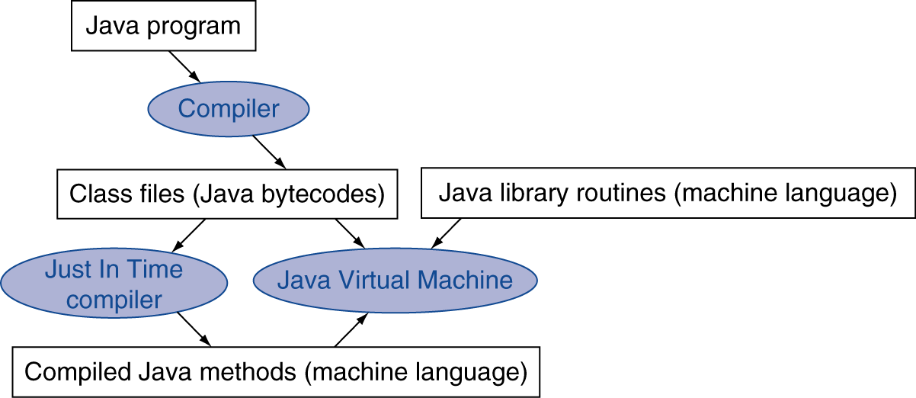
Starting Java Applications
Simple portable instruction set for the JVM
Compiles bytecodes of “hot” methods into native code for host machine
Interprets bytecodes

Slide 74
C Sort Example
Illustrates use of assembly instructions for a C bubble sort function
Swap procedure (leaf)
void swap(int v[], int k) { int temp; temp = v[k]; v[k] = v[k+1]; v[k+1] = temp; }
v in $a0, k in $a1, temp in $t0
§2.13 A C Sort Example to Put It All Together

Slide 75
The Procedure Swap
swap: sll $t1, $a1, 2 # $t1 = k * 4
add $t1, $a0, $t1 # $t1 = v+(k*4)
# (address of v[k])
lw $t0, 0($t1) # $t0 (temp) = v[k]
lw $t2, 4($t1) # $t2 = v[k+1]
sw $t2, 0($t1) # v[k] = $t2 (v[k+1])
sw $t0, 4($t1) # v[k+1] = $t0 (temp)
jr $ra # return to calling routine

Slide 76
The Sort Procedure in C
Non-leaf (calls swap)
void sort (int v[], int n)
{
int i, j;
for (i = 0; i < n; i += 1) {
for (j = i – 1;
j >= 0 && v[j] > v[j + 1];
j -= 1) {
swap(v,j);
}
}
}
v in $a0, k in $a1, i in $s0, j in $s1

Slide 77
The Full Procedure
sort: addi $sp,$sp, –20 # make room on stack for 5 registers
sw $ra, 16($sp) # save $ra on stack
sw $s3,12($sp) # save $s3 on stack
sw $s2, 8($sp) # save $s2 on stack
sw $s1, 4($sp) # save $s1 on stack
sw $s0, 0($sp) # save $s0 on stack
… # procedure body
…
exit1: lw $s0, 0($sp) # restore $s0 from stack
lw $s1, 4($sp) # restore $s1 from stack
lw $s2, 8($sp) # restore $s2 from stack
lw $s3,12($sp) # restore $s3 from stack
lw $ra,16($sp) # restore $ra from stack
addi $sp,$sp, 20 # restore stack pointer
jr $ra # return to calling routine

Slide 78
The Procedure Body
move $s2, $a0 # save $a0 into $s2
move $s3, $a1 # save $a1 into $s3
move $s0, $zero # i = 0
for1tst: slt $t0, $s0, $s3 # $t0 = 0 if $s0 ≥ $s3 (i ≥ n)
beq $t0, $zero, exit1 # go to exit1 if $s0 ≥ $s3 (i ≥ n)
addi $s1, $s0, –1 # j = i – 1
for2tst: slti $t0, $s1, 0 # $t0 = 1 if $s1 < 0 (j < 0)
bne $t0, $zero, exit2 # go to exit2 if $s1 < 0 (j < 0)
sll $t1, $s1, 2 # $t1 = j * 4
add $t2, $s2, $t1 # $t2 = v + (j * 4)
lw $t3, 0($t2) # $t3 = v[j]
lw $t4, 4($t2) # $t4 = v[j + 1]
slt $t0, $t4, $t3 # $t0 = 0 if $t4 ≥ $t3
beq $t0, $zero, exit2 # go to exit2 if $t4 ≥ $t3
move $a0, $s2 # 1st param of swap is v (old $a0)
move $a1, $s1 # 2nd param of swap is j
jal swap # call swap procedure
addi $s1, $s1, –1 # j –= 1
j for2tst # jump to test of inner loop
exit2: addi $s0, $s0, 1 # i += 1
j for1tst # jump to test of outer loop
Move params
Outer loop
Inner loop
Pass params & call
Inner loop
Outer loop

Slide 79
Example: Clearing and Array
clear1(int array[], int size) { int i; for (i = 0; i < size; i += 1) array[i] = 0; } | clear2(int *array, int size) { int *p; for (p = &array[0]; p < &array[size]; p = p + 1) *p = 0; }
move $t0,$zero # i = 0 loop1: sll $t1,$t0,2 # $t1 = i * 4 add $t2,$a0,$t1 # $t2 = # &array[i] sw $zero, 0($t2) # array[i] = 0 addi $t0,$t0,1 # i = i + 1 slt $t3,$t0,$a1 # $t3 = # (i < size) bne $t3,$zero,loop1 # if (…) # goto loop1 | move $t0,$a0 # p = & array[0] sll $t1,$a1,2 # $t1 = size * 4 add $t2,$a0,$t1 # $t2 = # &array[size] loop2: sw $zero,0($t0) # Memory[p] = 0 addi $t0,$t0,4 # p = p + 4 slt $t3,$t0,$t2 # $t3 = #(p<&array[size]) bne $t3,$zero,loop2 # if (…) # goto loop2

Slide 80
Comparison of Array vs. Ptr
Multiply “strength reduced” to shift
Array version requires shift to be inside loop
Part of index calculation for incremented i
c.f. incrementing pointer
Compiler can achieve same effect as manual use of pointers
Induction variable elimination
Better to make program clearer and safer

Slide 81
MIPS (RISC) Design Principles In Summary
Simplicity favors regularity
fixed size instructions
small number of instruction formats
opcode always the first 6 bits
Smaller is faster
limited instruction set
limited number of registers
limited number of addressing modes
Good design demands good compromises
Three instruction formats
Make the common case fast
arithmetic operands using the registers
Saving the commonly used registers into stack
PC-relative addressing
allow instructions to contain immediate operands

Slide 82
Effect of Compiler Optimization
Compiled with gcc for Pentium 4 under Linux

Slide 83
Effect of Language and Algorithm

Slide 84
Lessons Learnt
Instruction count and CPI are not good performance indicators in isolation
Compiler optimizations are sensitive to the algorithm
Java/JIT compiled code is significantly faster than JVM interpreted
Comparable to optimized C in some cases
Nothing can fix a dumb algorithm!

Slide 85
Alternative Architectures
Design alternative
provide more powerful operations
goal is to reduce number of instructions executed
danger is a slower cycle time and/or a higher CPI

Slide 86
ARM & MIPS Similarities
ARM: the most popular embedded core
Similar basic set of instructions to MIPS
§2.16 Real Stuff: ARM Instructions
 | ARM | MIPS
Date announced | 1985 | 1985
Instruction size | 32 bits | 32 bits
Address space | 32-bit flat | 32-bit flat
Data alignment | Aligned | Aligned
Data addressing modes | 9 | 3
Registers | 15 × 32-bit | 31 × 32-bit
Input/output | Memory mapped | Memory mapped

Slide 87
Compare and Branch in ARM
Uses condition codes for result of an arithmetic/logical instruction
Negative, zero, carry, overflow
Compare instructions to set condition codes without keeping the result
Each instruction can be conditional
Top 4 bits of instruction word: condition value
Can avoid branches over single instructions

Slide 88
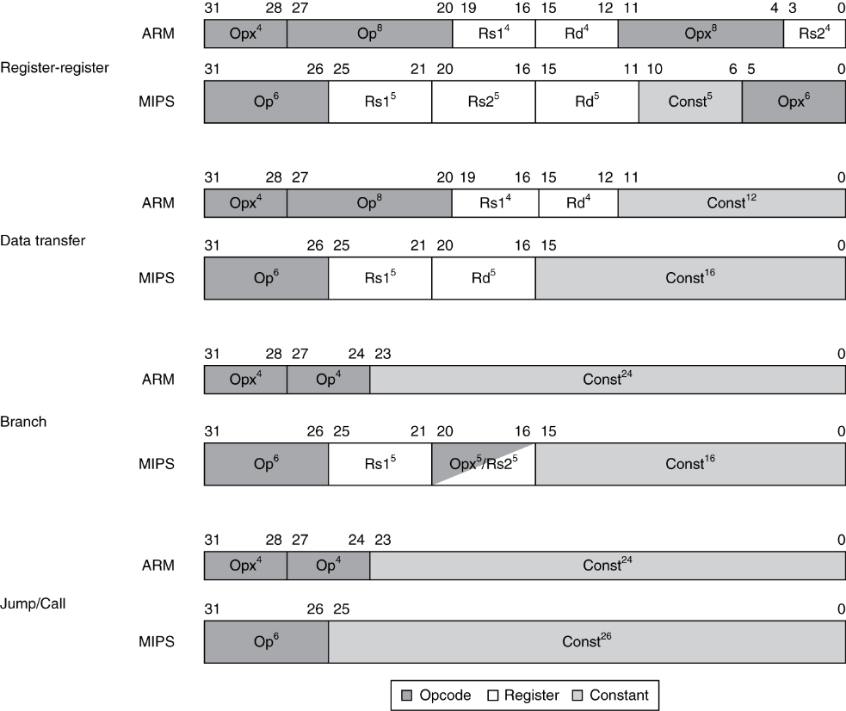
Instruction Encoding

Slide 89
The Intel x86 ISA
Evolution with backward compatibility
8080 (1974): 8-bit microprocessor
Accumulator, plus 3 index-register pairs
8086 (1978): 16-bit extension to 8080
Complex instruction set (CISC)
8087 (1980): floating-point coprocessor
Adds FP instructions and register stack
80286 (1982): 24-bit addresses, MMU
Segmented memory mapping and protection
80386 (1985): 32-bit extension (now IA-32)
Additional addressing modes and operations
Paged memory mapping as well as segments
§2.17 Real Stuff: x86 Instructions

Slide 90
The Intel x86 ISA
Further evolution…
i486 (1989): pipelined, on-chip caches and FPU
Compatible competitors: AMD, Cyrix, …
Pentium (1993): superscalar, 64-bit datapath
Later versions added MMX (Multi-Media eXtension) instructions
The infamous FDIV bug
Pentium Pro (1995), Pentium II (1997)
New microarchitecture (see Colwell, The Pentium Chronicles)
Pentium III (1999)
Added SSE (Streaming SIMD Extensions) and associated registers
Pentium 4 (2001)
New microarchitecture
Added SSE2 instructions

Slide 91
The Intel x86 ISA
And further…
AMD64 (2003): extended architecture to 64 bits
EM64T – Extended Memory 64 Technology (2004)
AMD64 adopted by Intel (with refinements)
Added SSE3 instructions
Intel Core (2006)
Added SSE4 instructions, virtual machine support
AMD64 (announced 2007): SSE5 instructions
Intel declined to follow, instead…
Advanced Vector Extension (announced 2008)
Longer SSE registers, more instructions
If Intel didn’t extend with compatibility, its competitors would!
Technical elegance ≠ market success

Slide 92
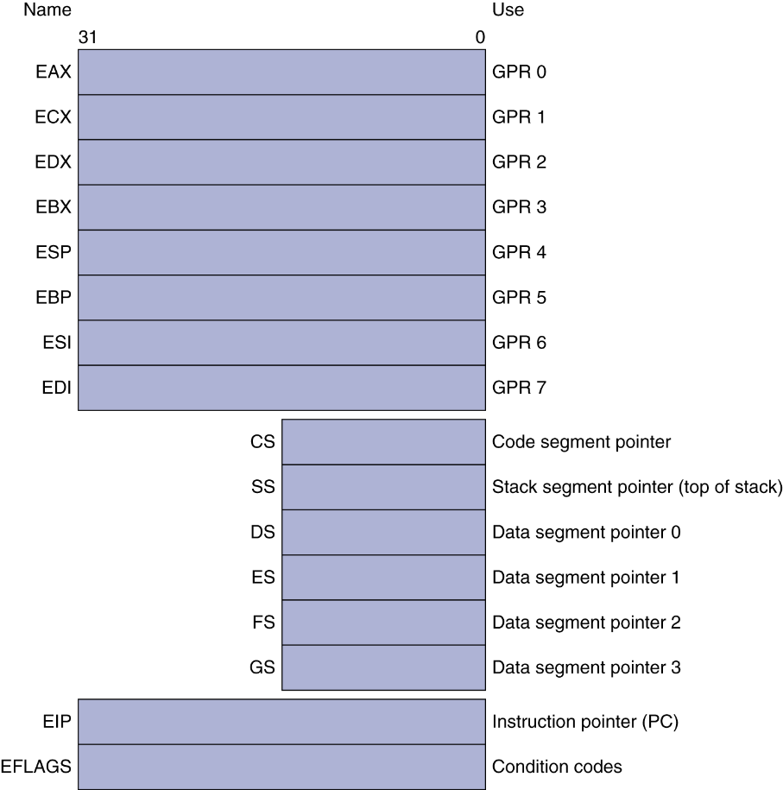
Basic x86 Registers

Slide 93
Basic x86 Addressing Modes
Two operands per instruction
Source/dest operand | Second source operand
Register | Register
Register | Immediate
Register | Memory
Memory | Register
Memory | Immediate
Memory addressing modes
Address in register
Address = R_{base} + displacement
Address = R_{base} + 2^{scale} × R_{index} (scale = 0, 1, 2, or 3)
Address = R_{base} + 2^{scale} × R_{index} + displacement

Slide 94
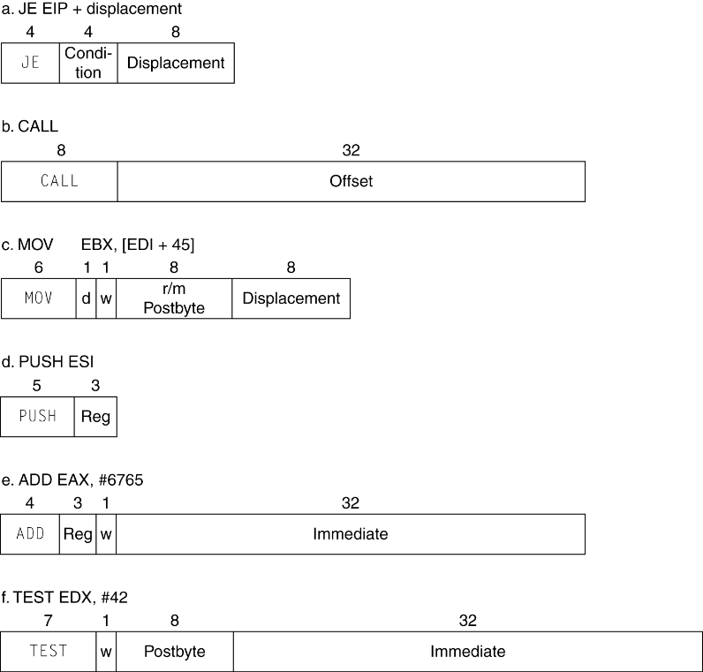
x86 Instruction Encoding
Variable length encoding
Postfix bytes specify addressing mode
Prefix bytes modify operation
Operand length, repetition, locking, …

Slide 95
Implementing IA-32 (Seg:Off)
Complex instruction set makes implementation difficult
Hardware translates instructions to simpler microoperations
Simple instructions: 1–1
Complex instructions: 1–many
Microengine similar to RISC
Market share makes this economically viable
Comparable performance to RISC
Compilers avoid complex instructions

Slide 96
ARM v8 Instructions
In moving to 64-bit, ARM did a complete overhaul
ARM v8 resembles MIPS
Changes from v7:
No conditional execution field
Immediate field is 12-bit constant
Dropped load/store multiple
PC is no longer a GPR
GPR set expanded to 32
Addressing modes work for all word sizes
Divide instruction
Branch if equal/branch if not equal instructions
§2.18 Real Stuff: ARM v8 (64-bit) Instructions

Slide 97
Fallacies
Powerful instruction ⇒ higher performance
Fewer instructions required
But complex instructions are hard to implement
May slow down all instructions, including simple ones
Compilers are good at making fast code from simple instructions
Use assembly code for high performance
But modern compilers are better at dealing with modern processors
More lines of code ⇒ more errors and less productivity
§2.19 Fallacies and Pitfalls

Slide 98
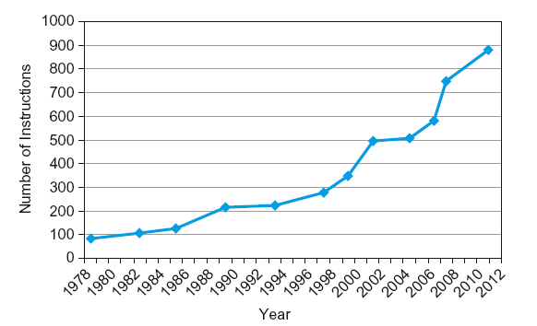
Fallacies
Backward compatibility ⇒ instruction set doesn’t change
But they do accrete more instructions
x86 instruction set

Slide 99
Pitfalls
Sequential words are not at sequential addresses
Increment by 4, not by 1!
Keeping a pointer to an automatic variable after procedure returns
e.g., passing pointer back via an argument
Pointer becomes invalid when stack popped

Slide 100
Concluding Remarks
Design principles
1. Simplicity favors regularity
2. Smaller is faster
3. Make the common case fast
4. Good design demands good compromises
Layers of software/hardware
Compiler, assembler, hardware
MIPS: typical of RISC ISAs
c.f. x86
§2.20 Concluding Remarks

Slide 101
Concluding Remarks
Measure MIPS instruction executions in benchmark programs
Consider making the common case fast
Consider compromises
Instruction class | MIPS examples | SPEC2006 Int | SPEC2006 FP
Arithmetic | add, sub, addi | 16% | 48%
Data transfer | lw, sw, lb, lbu, lh, lhu, sb, lui | 35% | 36%
Logical | and, or, nor, andi, ori, sll, srl | 12% | 4%
Cond. Branch | beq, bne, slt, slti, sltiu | 34% | 8%
Jump | j, jr, jal | 2% | 0%

Slide 102
Acknowledgements
These slides contain material developed and copyright by:
Lecture slides by Dr. Tanzima Hashem, Professor, CSE, BUET
Lecture slides by Mehnaz Tabassum Mahin, Assistant Professor, CSE, BUET

Slide 103
Thank You ☺

